Slide 1
Browsing large image datasets through Voronoi diagrams
Paolo Brivio, Marco Tarini, Paolo Cignoni
Notes:
I’m going to talk about a new thumbnail bar for the visualization of large image datasets.

Slide 2
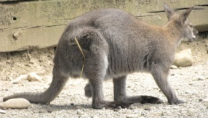
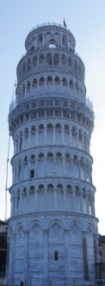
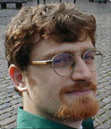
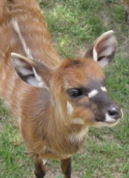
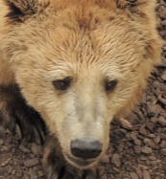
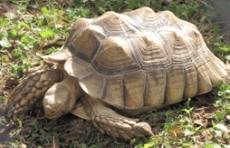
Targeted image datasets
Fairly large datasets (i.e. 1000s images)
cannot be all visible at the same time
Non-uniform image aspect ratio
landscape vs portrait
image orientation
Total ordering
e.g. time of shot, some ordering defined over calibration, user-defined sequence, etc.
Allow to specify per-image importance
i.e. each image represents a subset of the dataset
Notes:
We target the browsing of dataset of images which cannot be all visible at the same time on a screen.
In such datasets images usually have varying aspect ratios and can have different orientations.
It is also rather common to have a total ordering defined over the images.
For instance, the time of shot for a set of photographs, rather than some ordering defined over a calibrated dataset, and so on.
Thus, requiring a total ordering does not restrict too much the variety of datasets we can treat.
As last requirement, it should be possible to specify a per-image importance,
such that each one represents a subset of others.

Slide 3
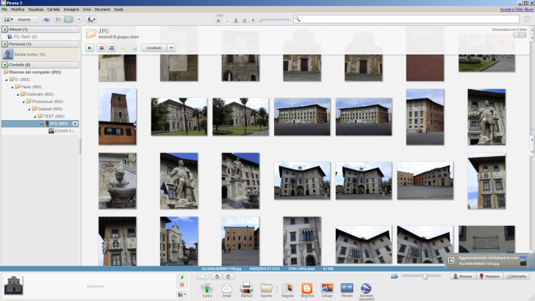
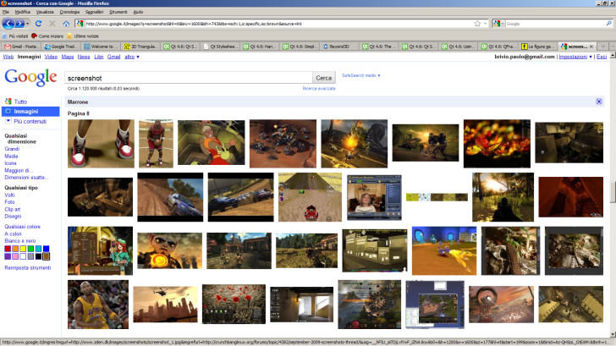
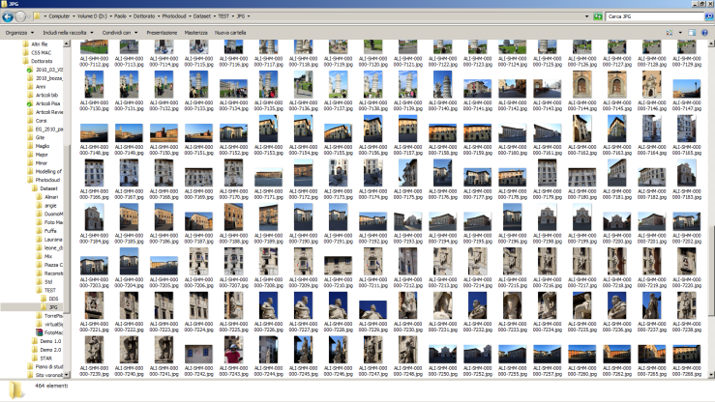
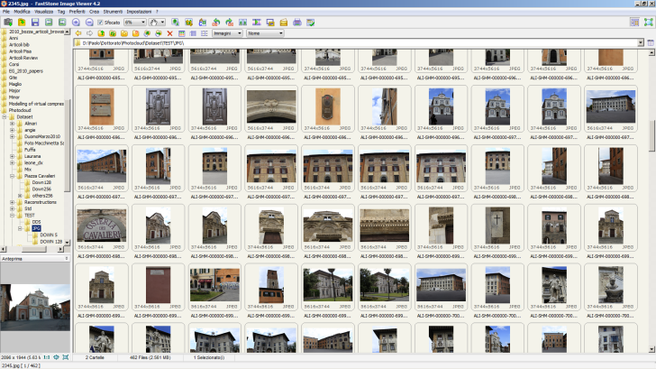
Conventional image browsers (fullscreen)
Rectangular grid of image thumbnails
[opt] on scrolling panels
Explorer
by Microsoft
Google Image
by Google
Picasa3
by Google
FastStone
Notes:
Nowadays, we know how easy is to produce thousands of photographs using a camera,
and how large are the datasets available on the Internet.
With such datasets, conventional image-browsers perform less well,
in that at any given moment it is possible to show only a subset of the images.
Scrolling panels are a typical way to change this subset.

Slide 4
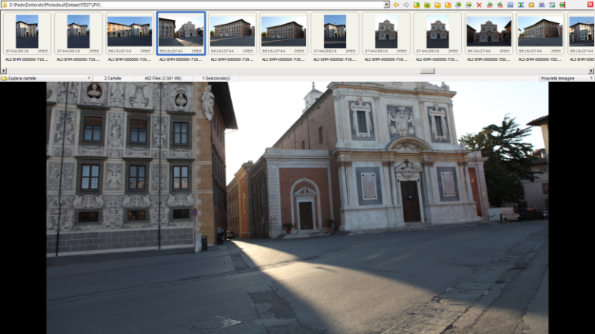
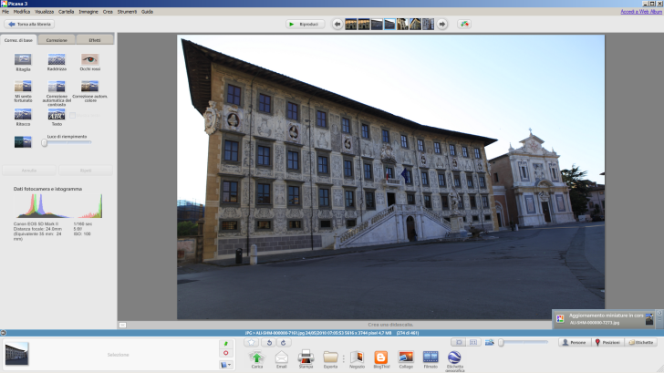
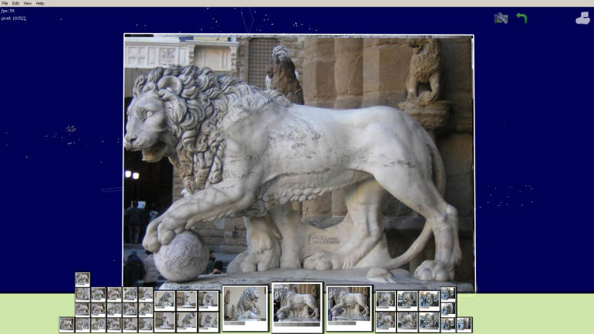
Conventional image browsers (thumbnail bars)
Sequence of image thumbnails
[opt] scrollbars or buttons
Picasa3 by Google
FastStone
PhotoCloud by ISTI-CNR
Notes:
This drawback is even more emphasized for those browsers which devote a large area of the screen
to show something else, like for instance a high resolution version of the selected thumbnail, or a 3D model, and so on.
In such cases, the browsing is limited by a small thumbnail bar.

Slide 5
Notes:
Large datasets need very long bars!

Slide 6
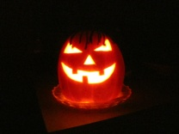
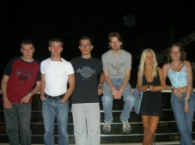
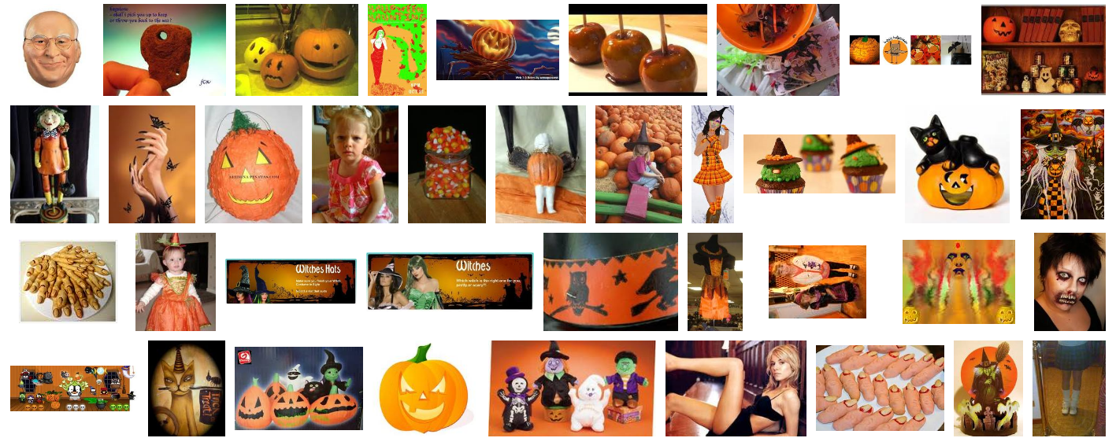
Other drawbacks: non-uniform aspect ratios
wasted space
Google Image
Notes:
Besides that, let’s now consider a regular grid browser:
the way we can fill each cell varies according to the image aspect ratio.
When the image aspect does not match the aspect of the cells, some cell space is inevitably wasted.
This is even more emphasized in presence of more “extreme” aspects as in the case of panoramic images.
Now, consider the case of self-shot photographs: pictures have often different orientations
which can be “corrected” by means of rotations around the pictures depth-axis.
Another time, some browser space is wasted.
Some browsers face the aspect-ratio problem by computing a packing of the images,
which performs generally well, but again suffering from isolated “extreme” aspects.

Slide 7
A new type of thumbnail bar
focus
image
Notes:
We propose an alternative Thumbnail Bar, which can be arbitrarily-shaped as shown in the image.
It is composed of irregularly shaped thumbnails.
Each thumbnail shape reflects the aspect ratio of the represented image. And even its orientation , if available.
One thumbnail has a special role: the *focus* image. It is the currently selected image. For example, depending on the application, in can be the image currently on display on the rest of the screen, or the currently selected viewpoint, and so on.

Slide 8
Thumbnail sizes
far from focus: small thumbnails
focus
image
near to focus: large thumbnails
Notes:
The current focus image is shown as a large thumbnail, so that the user can see better its content.
Then, as we go farther from the focus, thumbnails become progressively smaller,
as the user is probably less interested to them.

Slide 9
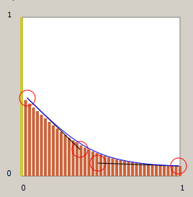
Thumbnail sizes
thumbnail size
focus
image
distance from focus
in image list
0 (focus image)
±10
±20

Slide 10
Clustering images
far from focus: each thumbnail represents many images
focus
image
near to focus: 1 thumbnail for 1 image
Notes:
At any given moment, a subset of the entire dataset is visible inside the thumbnail area.
Given an importance for each image, we can cluster images so that near to the focus
each image represents only itself, while going towards the thumbnail area edges
each image increasingly represents more and more others.

Slide 11
Selecting visible images
visible
image
focus
image
custom fuction
representativeness
hidden
image
image number
1
2
3
4
5
6
7
focus

Slide 12
Spatial ordering
x-axis: image ordering respected
focus
image
y-axis: arbitrary
previous images in the ordering
following images in the ordering
Notes:
In this representation, a visual ordering is strictly maintained from left to right, as the images ordering is respected along the x-axis.
Along the y-axis, however, an arbitrary image disposition is allowed.
The net effect is that with respect to the focus image, on the left side we have a continuously ordered set of previous images in the ordering,
while on the other side we have a continuously ordered set of following images in the ordering.
Given an x-distance from the focus, all the image-ordering distances of thumbnails from the focus
are in general comparable among them.

Slide 13
Not only horizontal thumbnail bars
Define a parametric domain in which the ordering is enforced
Arbitrary thumbnail-bar shape
enforce ordering
custom parametric function
Parametric domain
Thumbnail-bar shape
Notes:
For completeness

Slide 14
Transitions
new focus
focus
image
focus
image
Packing of thumbnails
arbitrary bar shape
irregular shaped thumbnails
varying size
fitting aspect/orientation
image ordering respected
1 thumbnail per image cluster
Notes:
The user can select at anyone moment any visible thumbnail by clicking on it with a pointer.
In this example, let’s select a thumbnail on the right.

Slide 15
Transitions
new
focus
Packing of thumbnails
arbitrary bar shape
irregular shaped thumbnails
varying size
fitting aspect/orientation
image ordering respected
1 thumbnail per image cluster
Animated transition
with
temporal coherence
Notes:
We obtain a new configuration in which the focus image has been replaced by the new one,
and all the described diagram features are preserved.
During the transition between the two static configurations, many images move.
Contemporarily, some images disappear, others might appear at the borders or inside the diagram (between two existing thumbnails).
Some images are enlarged, like the new focus, while others become smaller, like the previous focus.
Every change smoothly converges to its final state, leading to an animation with temporal coherence.
Image movements across the thumbnail area are a direct consequence of both the resizing and the
add/remove of other images.

Slide 16
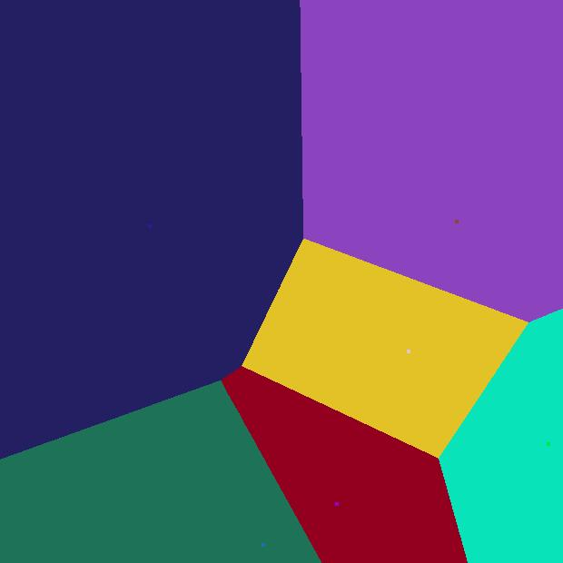
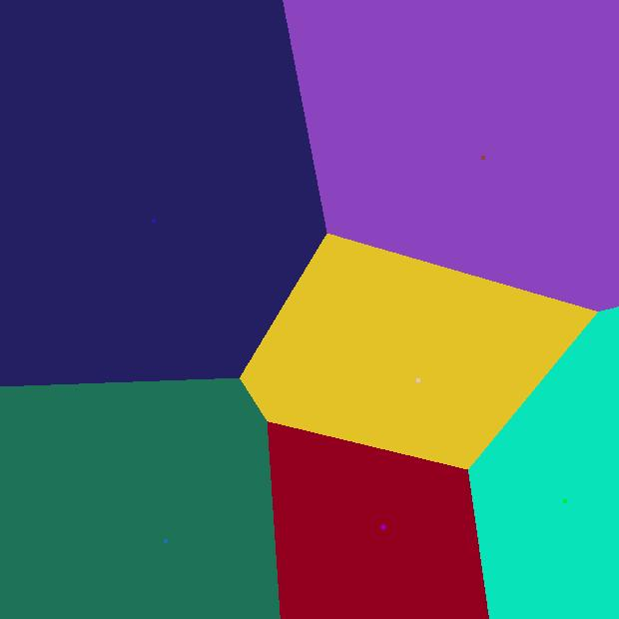
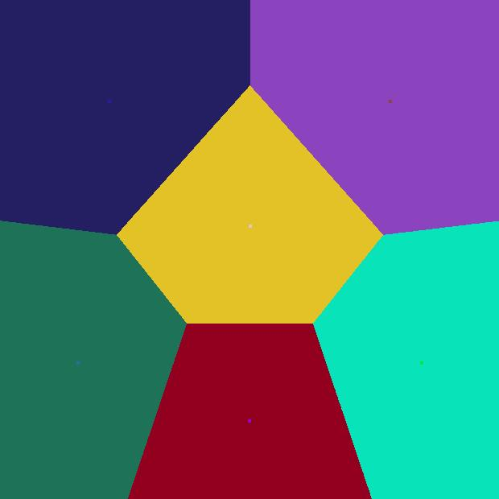
Autorecentering Voronoi diagrams
Voronoi diagram:
given a set of 2D “seeds” inside a 2D figure F
partition F into as many “regions”
a point belongs to the region of the closest seed
Autorecentering step (Lloyd relaxation):
move seed (●) of each region in its barycenter (+)
x 1
x n
Notes:
To obtain such an image browser, we exploit a well known plane partition called Voronoi diagram.
Just as a brief recall, given a plane and a set of points called seeds, the Voronoi diagram
is the plane partition in which each seed defines the region of points which are nearer to that seed than to any other seed.
Then we add an auto-recentering step, using the Lloyd algorithm:
for each region, we compute its barycenter and move its seed there.
Then, we recompute the Voronoi diagram for the new seeds positions in an iterative process
which brings to equireal regions.
Generally, autorecentering Voronoi diagrams are widely studied for their final configuration properties,
but we are also interested in all the process that transforms a Voronoi diagram into another,
because this is our base mechanism to obtain animations.
Our browser however requires a slightly different version of autorecentering Voronoi diagrams.

Slide 17
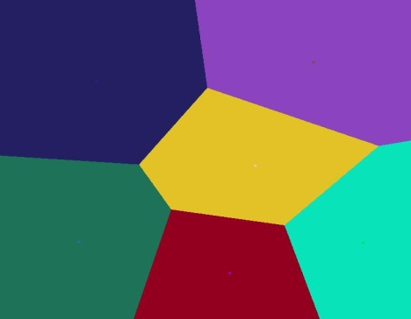
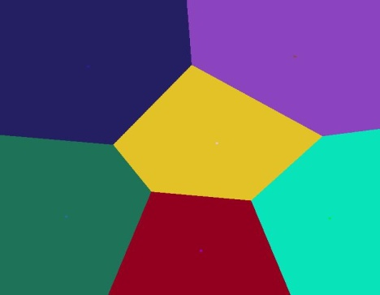
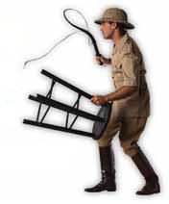
Taming autorecentering Voronoi diagrams
Notes:
Thus, we have to “tame” them. Let’s see how.

Slide 18
Taming autorecentering Voronoi diagrams 1/2
Weighting for region size differentiation
Power Diagram
Dynamic weight balancing
match required region sizes
smooth transitions
including: smooth appear/disappear of regions
Ordering enforcing (over “x”)
interleaved with recentering step
Anisotropy: make regions appropriate
…aspect ratio
…orientation (non axis-aligned)
Notes:
So we have said that autrecentering Voronoi diagrams generate regions with the same area.
We can differentiate each region size by additively weighting each region, adopting the so called “Power Diagram”.
By dynamically reweighting the diagram, we obtain smooth transitions and we can even make regions smoothly appear or disappear from anywhere.
The recentering step, however, does not ensure that regions maintain their relative ordering along the x-axis, thus we enforce it at every iteration.
Then, we deform each region accordingly to its associated thumbnail aspect ratio and orientation.

Slide 19
Taming autorecentering Voronoi diagrams 2/2
Stabilization
prevent oscillations
Small extra forces
pulling regions toward expected positions
accelerate convergence
Accept user “dragging” mouse gesture
Real time computation
efficient GPU implementation
Notes:
Yet, the system is still not tamed, and it tends to oscillate near convergence, but it is not too difficult to stabilize it.
For a general speed up of the system, we apply extra forces to pull regions in their expected positions.
It is also possible to tie a region to the current mouse position, letting the rest of the system follow it.
Constraining the position of the region being dragged.

Slide 20
Tamed autorecentering Voronoi diagrams
optional
bulge-out
effect
Packing of thumbnails
arbitrary bar shape
irregular shaped thumbnails
varying size
fitting aspect/orientation
image ordering respected
1 thumbnail per image cluster
Animated transition
with
temporal coherence
Notes:
Ora abbiamo la nostra bar animata divisa in regioni che rispecchiano le dimensioni che volevamo e hanno aspect e persino orientamento per l’immagine che devono embeddare. Ora si riempiono le regions coi thumbnail. Come? (immagine senza thumbnail + box regole riassuntivo)
The result is an arbitrarily shaped thumbnail bar
We can make regions bulge out from the bar shape. That’s controlled with another parameter.

Slide 21
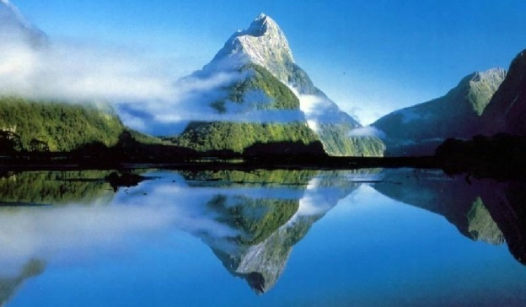
Thumbnail creation
+ resizing
original image
- cropping
+
region shape
- resizing
+ cropping
Notes:
Let’s now see how we fill regions with thumbnails.
Given an image with possibly an orientation and given an irregular region,
which has approximately the same image aspect and orientation,
we can produce at least three different fillings:
- either resizing the image thumbnail into the region,
or cropping the thumbnail to fit into the region,
or even more cropping the thumbnail by zooming into it.

Slide 22
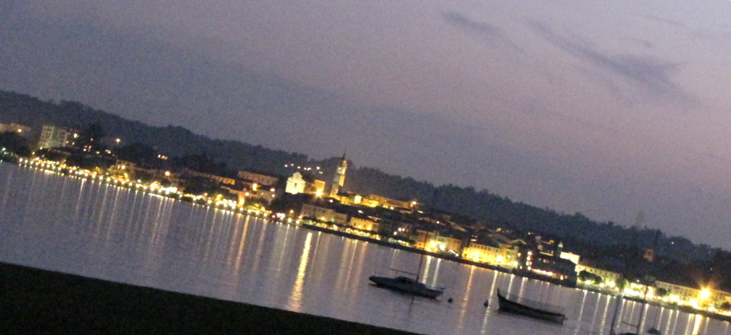
Thumbnail creation: with per-image orientation
+ resizing
original image
- cropping
+
region shape
- resizing
+ cropping

Slide 23
Example
Notes:
For example, we can generate a thumbnail bar by filling the regions with resized thumbnails.
As said, this lets some empty space be present around each thumbnail as happens in conventional browsers.
But the underlying Voronoi diagram ensures that a good packing is achieved.
Still, all our desired Voronoi diagram properties are preserved.

Slide 24
More examples
Notes:
Manipulating these and other parameters, we can obtain a wide range of useful thumbnail bars.
We can have
Any/different thumbnail bar shapes
Any/different thumbnail size distributions
Any/different ways to fit thumbnails inside regions
Any/different clusterings
Any/different strategies at borders

