Slide 1
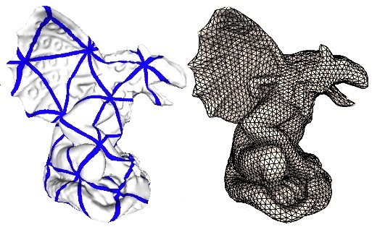
  N.Pietroni, M.Tarini, P.Cignoni. Almost isometric mesh parametrization through abstract domains
  IEEE Transactions on Visualization and Computer Graphics. 2009
Notes:
Videos:
- texture interpolation (mi manca)

Slide 2
Objectives
D
M
1TO1
⬅
➔
PARAMETRIZATION DOMAIN
3D TRIANGLE MESH
Low distortion (preserves area & angles)
Low domain complexity:
  tangent directions over the mesh vary smoothly.
  points on the domain have a well defined, easy to find, large neighborhoods around them.
  It is possible to interpolate between positions on the domain.
  The domain can be embedded in a 2D REGION.

Slide 3

OVERVIEW

Slide 4
Structure of D
A collection of equilateral triangles D₀…D_{n}
  called subdomains
  No 3D embedding (ABSTRACT)
  Only connectivity needed
A position in D is a triple (α,β,I)
  (α,β) are barycentric cordinates.
  0<=I<=n is the the index of subdomain.

Slide 5
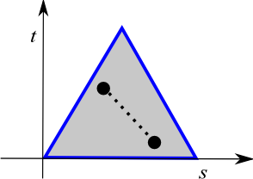
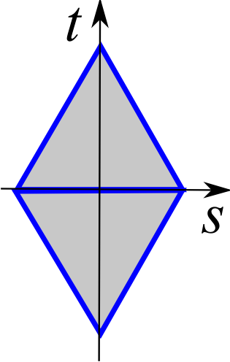
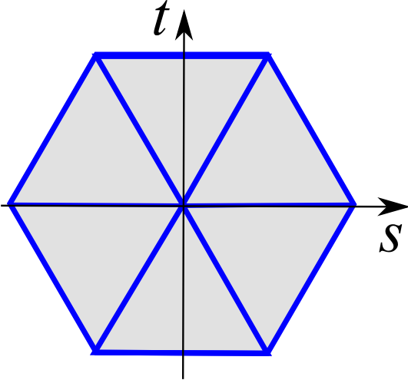
How to interpolate on D?
Given 2 positions in D (α₀,β₀,I₀) and (α₁,β₁,I₁):
  If (I₀==I₁) then simply use an
  equilateral triangle
  Else use interpolation domains:
    Diamond
    2 equilateral triangles
    Star
    k triangles rescaled to match
    total area of k equilateral triangles

Slide 6
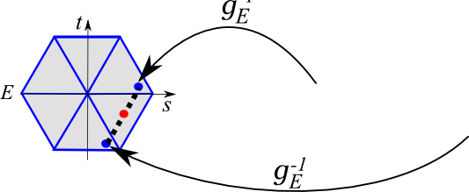
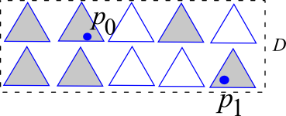
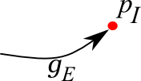
How to interpolate on D?

Slide 7
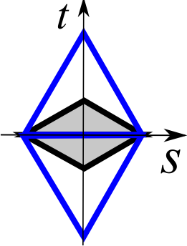
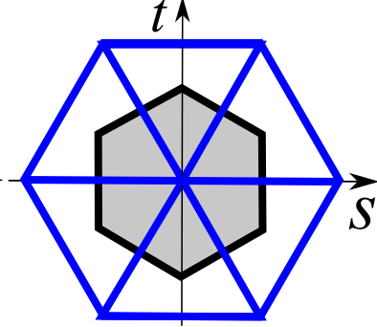
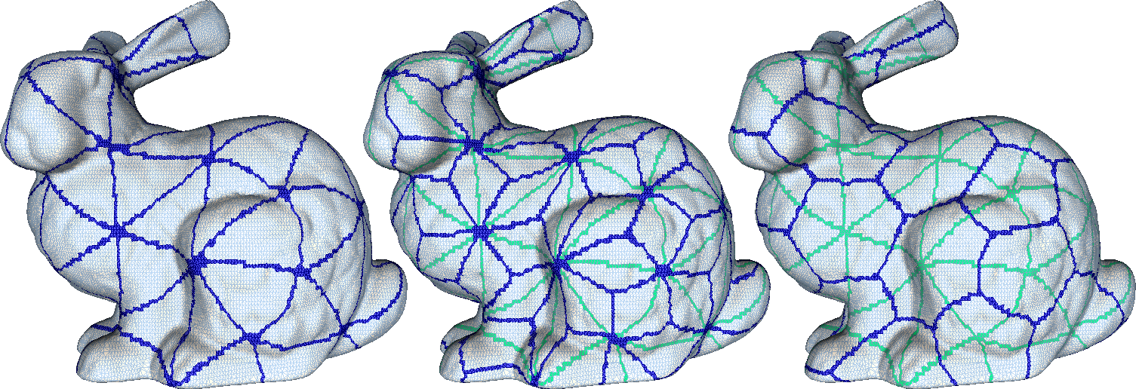
Partitioning D
3 sets of interpolation domains now partition the entire parametric domain:
  Face domains (same faces as D)
  Half diamonds
  Half stars

Slide 8
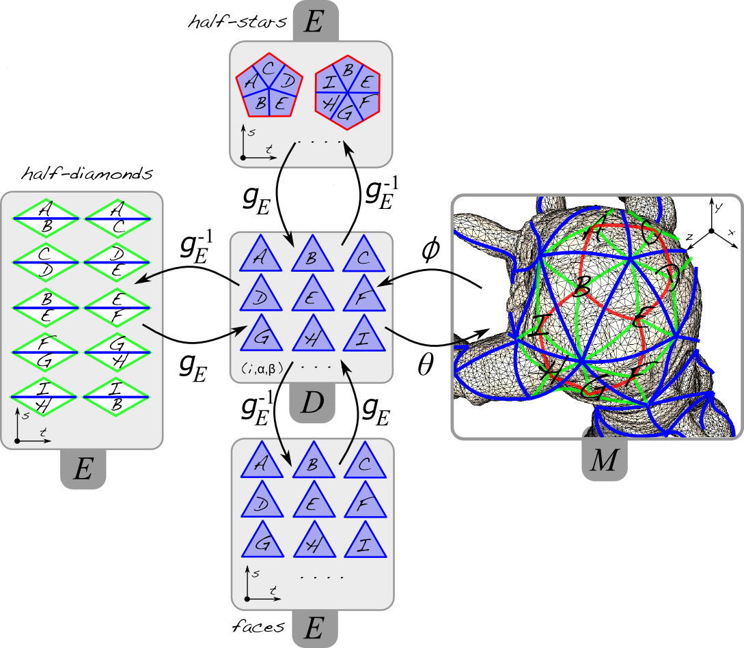

Slide 9
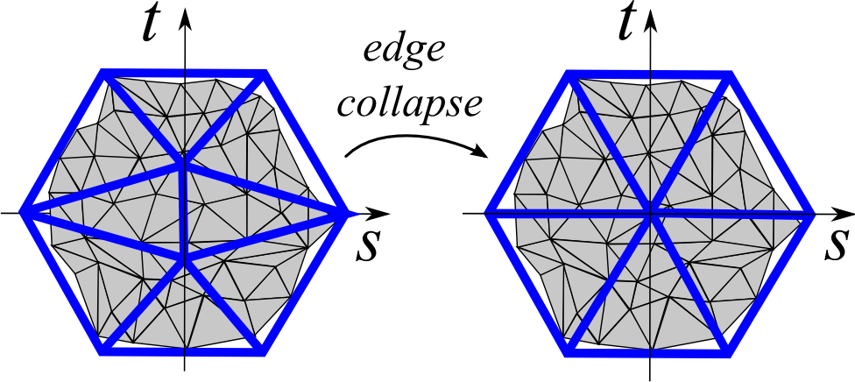
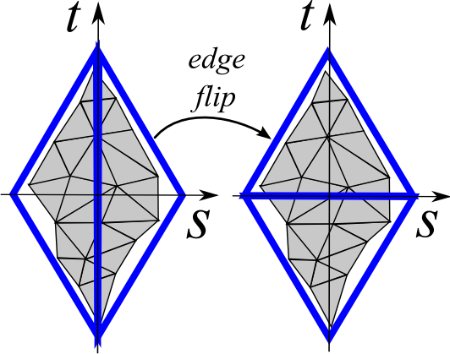
Gathering D
Two local operations with updating of M to D mapping:
  Edge collapse
  Edge flip
Local optimization with area preservation

Slide 10
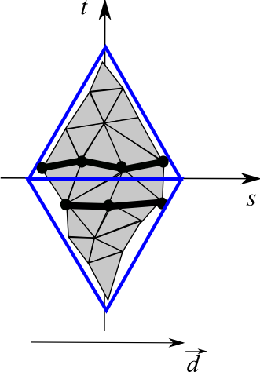
Prioritizing operations
Collapse the shorter edge
Flip if edge length decrease
How we may calculate length if we do NOT have 3D coordinates of D?
Evaluate edge lengths OVER the original mesh

Slide 11
Final global optimization
Optimize each partition until convergence

Slide 12
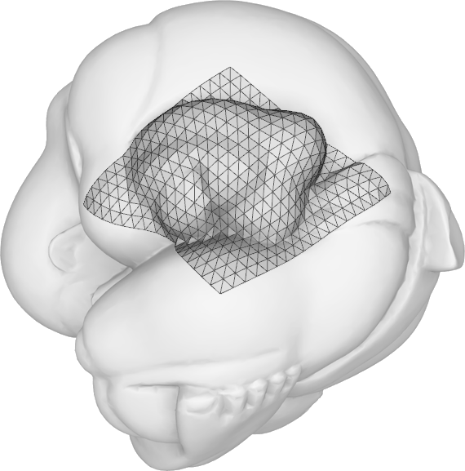
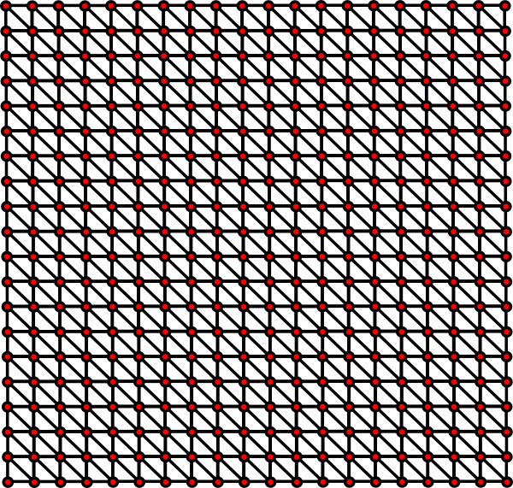
Remeshing and geometry processing

Slide 13
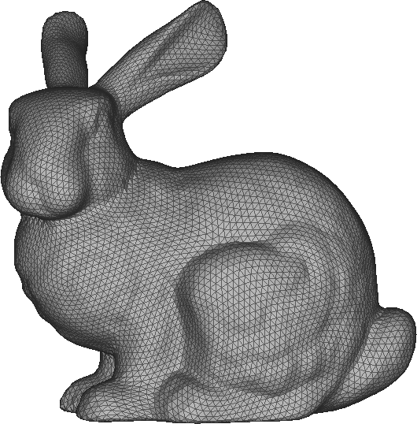
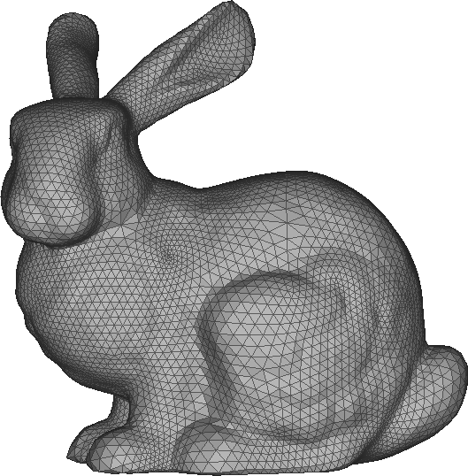
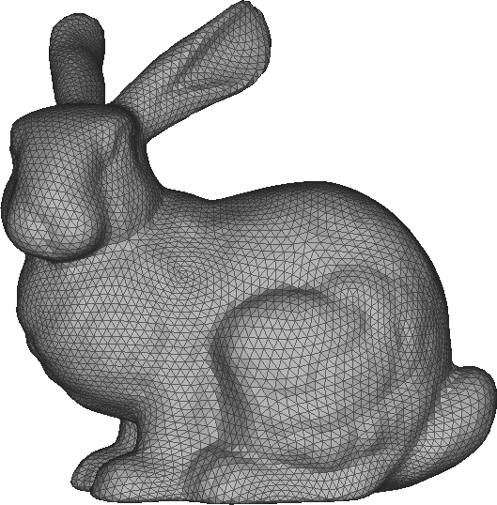
results
Intersurface mapping
John Schreiner et al
Globally smooth param.
Andrei Khodakovsky et al.
Proposed

Slide 14
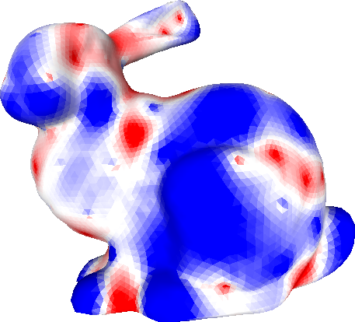
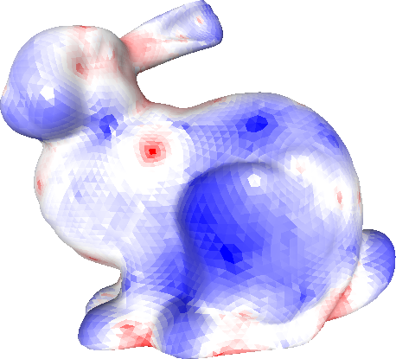
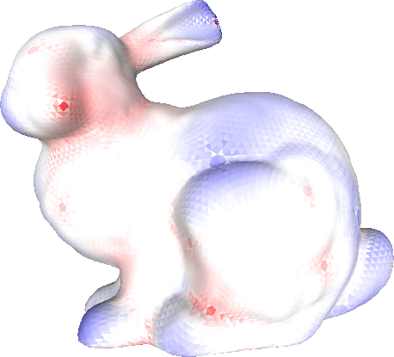
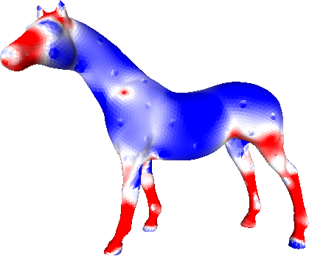
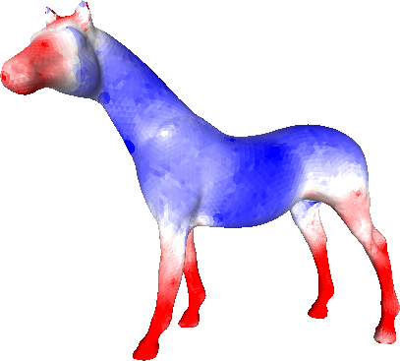
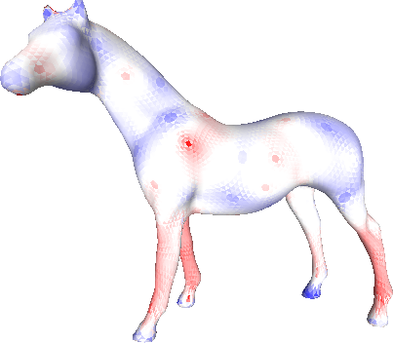
Results:area preservation
Globally smooth
Intersurface mapping
proposed

Slide 15
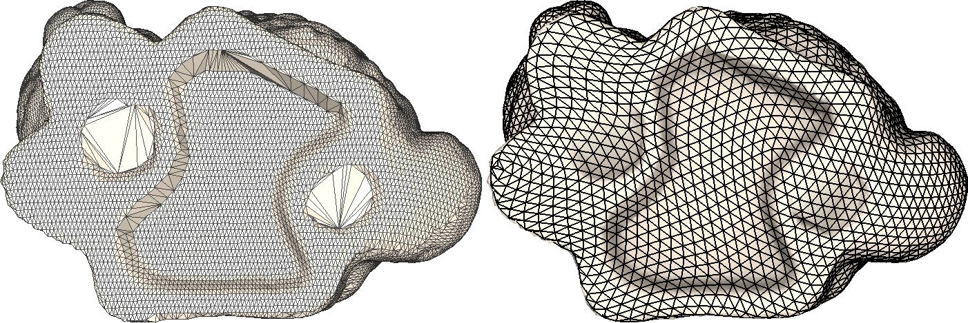
ROBUSTNESS

Slide 16
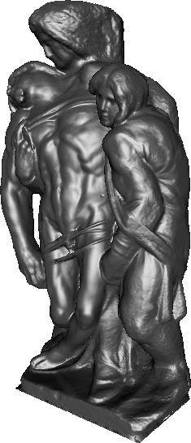
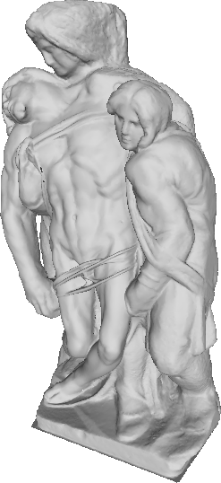
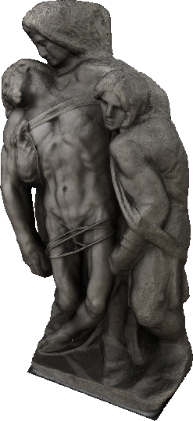
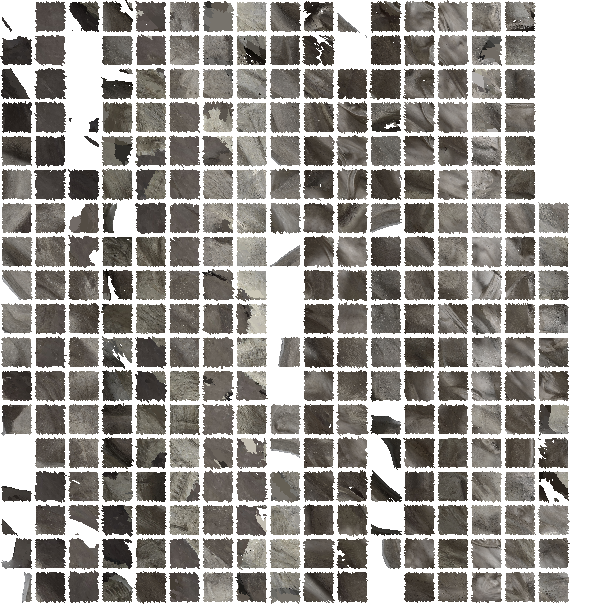
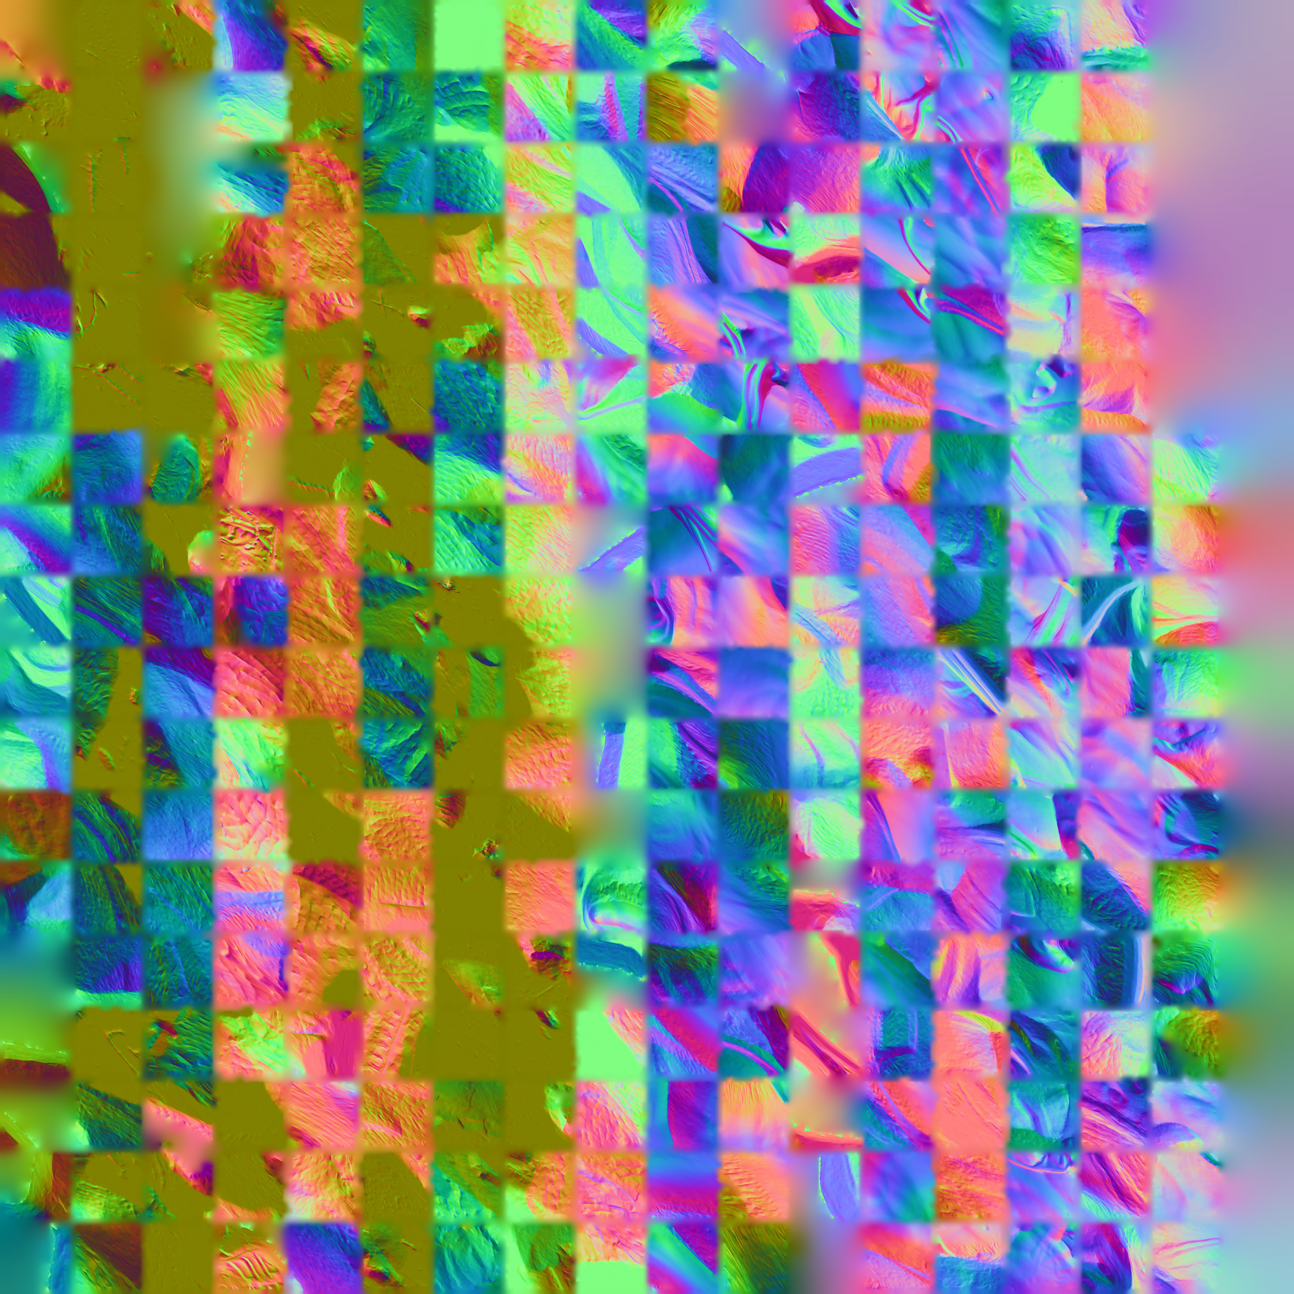
APPLICATION TO SCANNED MODELS

Slide 17

A SHORT VIDEO

Slide 18
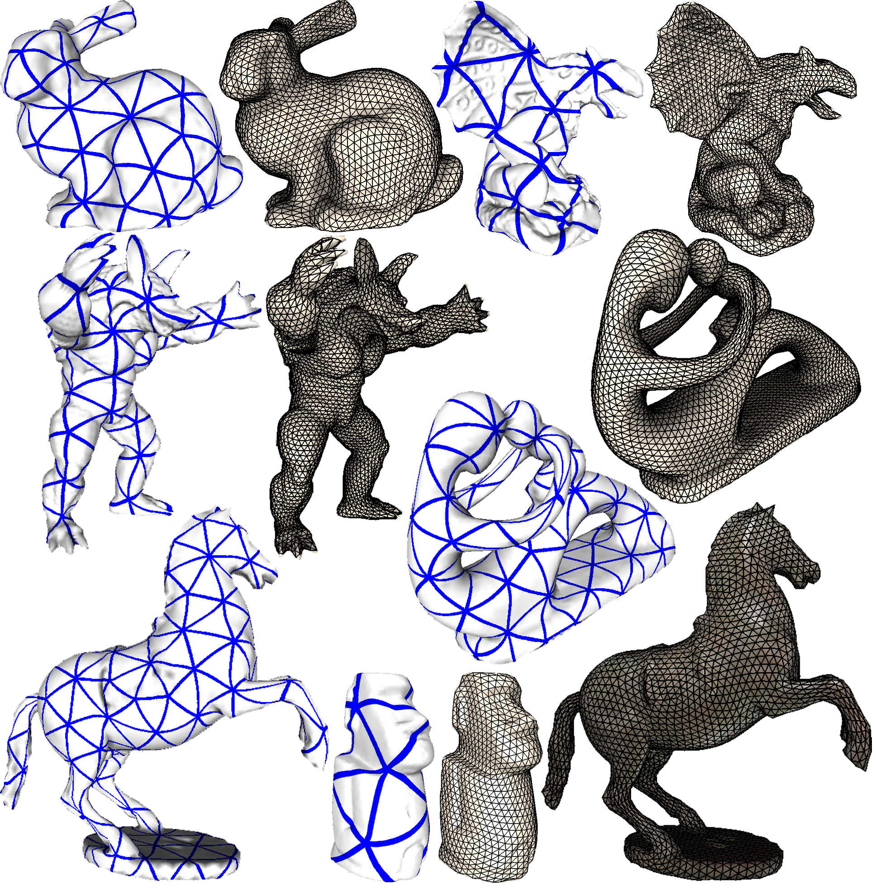
More results on the paper…

