Slide 1
Topological classification of Vittorio giorgini’s sculptures
Bridges 2020
Daniela Giorgi¹, Marco Del Francia², Massimo Ferri³, Paolo Cignoni¹
¹ISTI-CNR, Pisa, Italy
²B.A.Co - Archivio Vittorio Giorgini, Italy
³University of Bologna, Italy

Slide 2
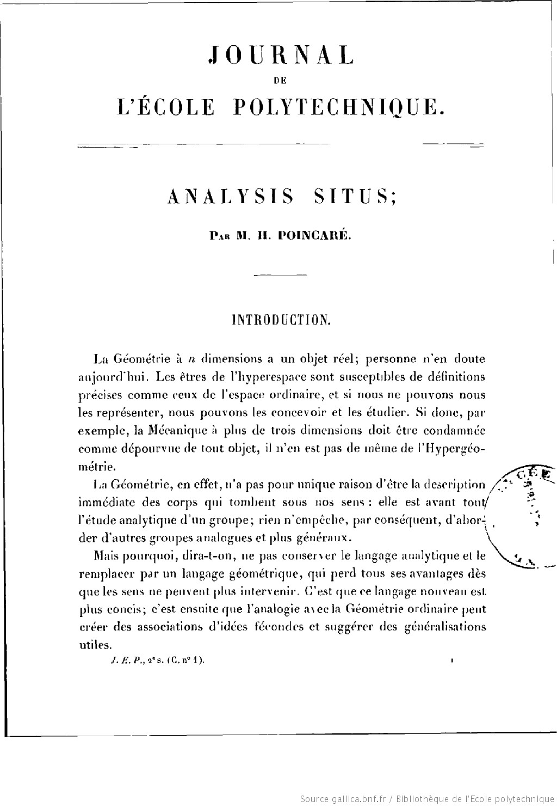
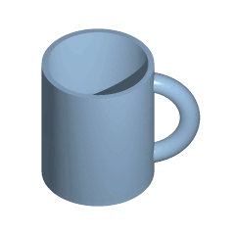
Topology
[http://gallica.bnf.fr/ark:/12148/bpt6k4337198.image.r=langFR.f7.pagination]
The 19th century saw the development of topology, a branch of mathematics which studies the properties of geometrical objects that are invariant under continuous transformations.
In the subsequent decades, topology would have a great influence on the way in which artists and architects sensed and represented space.
[https://en.wikipedia.org/wiki/File:Mug_and_Torus_morph.gif]

Slide 3
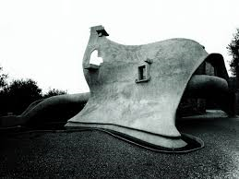
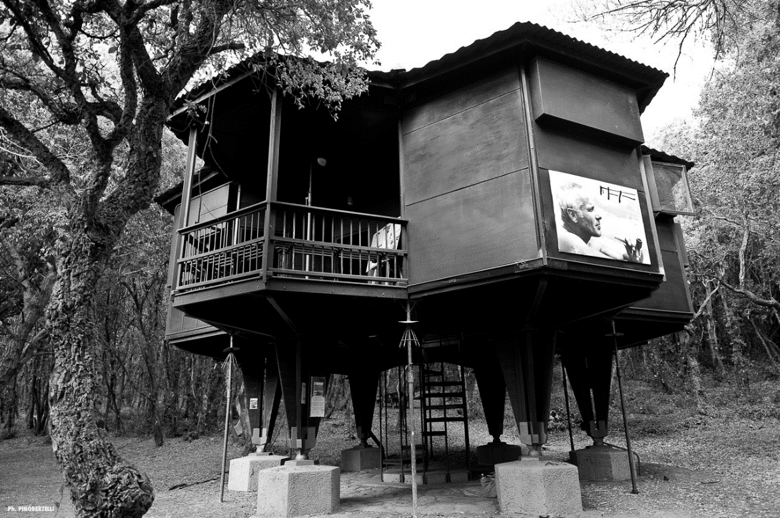
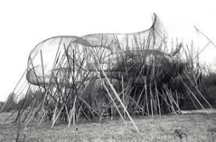
Vittorio Giorgini, a morphological architect
The Italian architect Vittorio Giorgini (1926 - 2010) pioneered the topology-flavoured ideas of elastic surfaces and of form as a dynamic structure.
His beautiful architectural designs, largely unrecognized in his lifetime, have recently drawn the attention they deserve.
[Casa Salderini, Gulf of Baratti (Italy)]
[Casa Esagono, Gulf of Baratti (Italy)]
[Liberty project, New York (USA)]

Slide 4
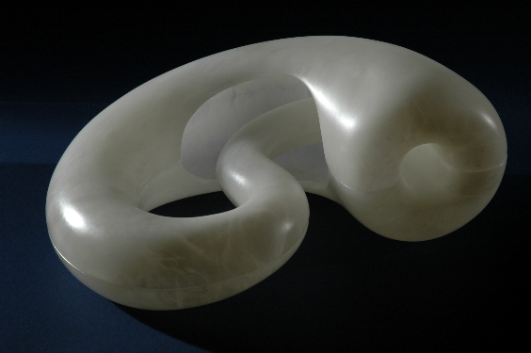
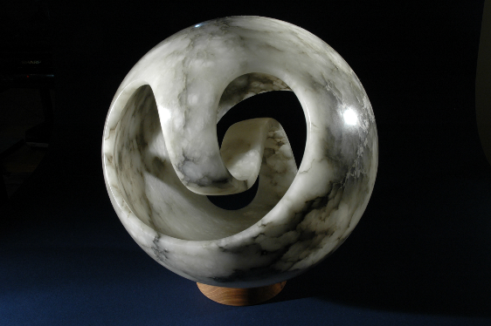
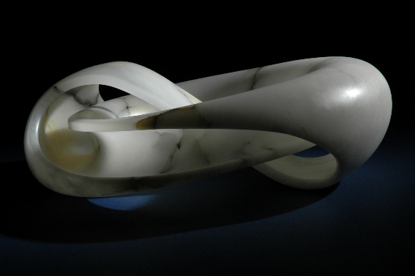
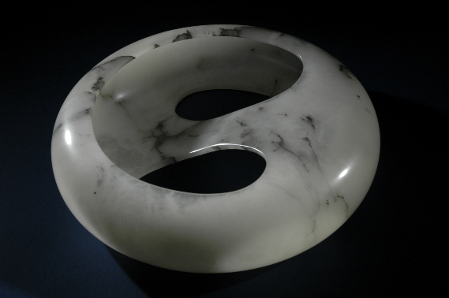
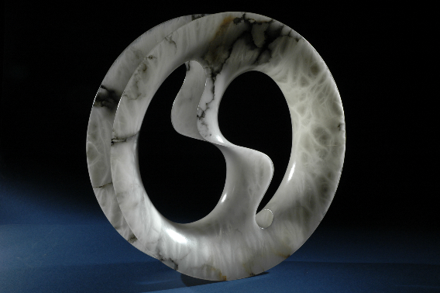
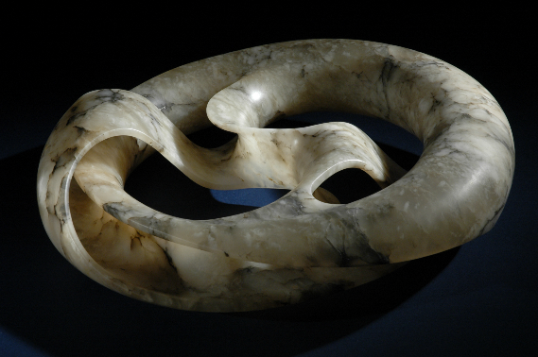
Vittorio Giorgini’s sculptures
Giorgini also left a few enchanting sculptures, in which he explored the connection between shape and topology. They represent non-orientable (i.e., one-sided) surfaces.
Giorgini inherited Leonardo da Vinci’s idea idea of variations in nature: Giorgini shows how removing parts of the surfaces and connecting the so-formed boundaries give rise to different form variations.

Slide 5
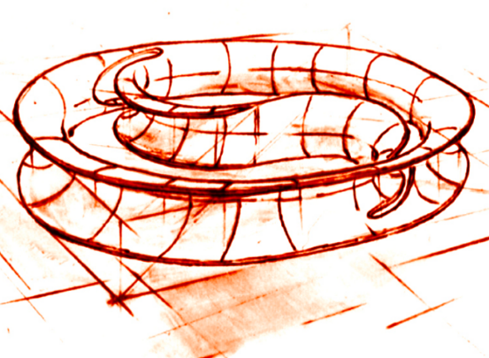
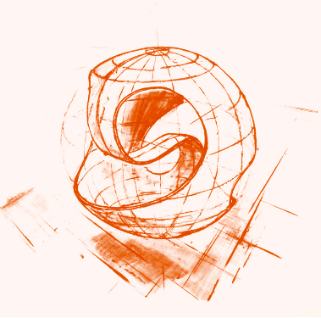
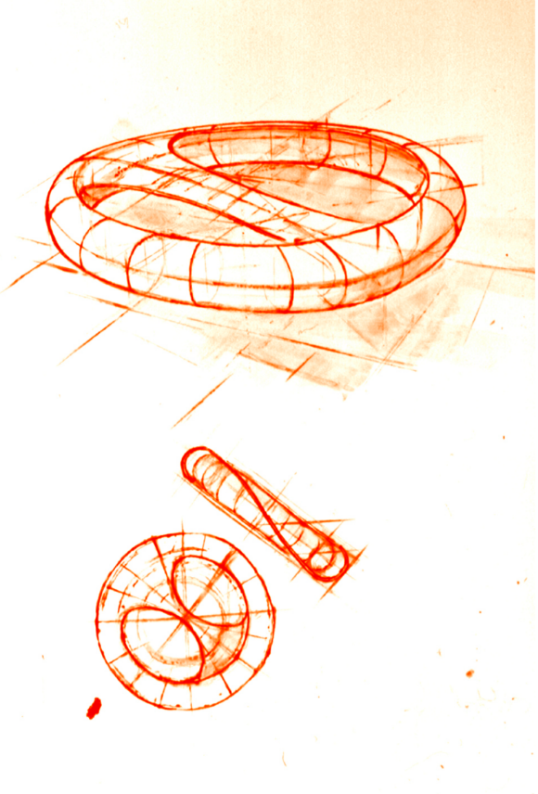
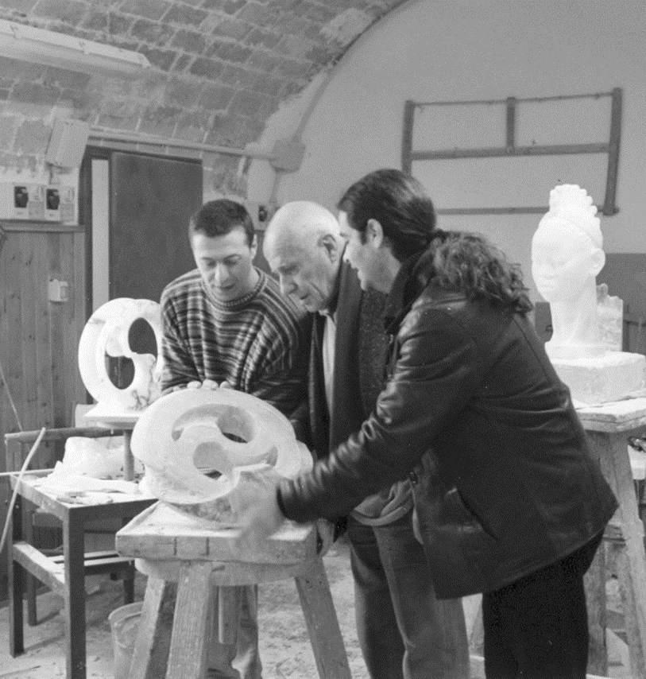
From paper to alabaster
Giorgini designed his three-dimensional figures in-between the late 1960’s and the first half of the 2000’s. The figures only existed as bi-dimensional drawings for many years.
Then, Giorgini asked David Dainelli and Alessandro Marzetti to carve alabaster sculptures from his drawings, in their artistic workshop in Volterra (Pisa, Italy), under his direct supervision.

Slide 6
Modified Klein
[Modified Klein; width: 20 inches; height: 6 inches; material: alabaster]
Modified Klein is a Klein bottle with a disk removed. The Klein bottle is a non-orientable surface, which is closed but does not enclose an interior.
As it often happens with physical reproductions, Giorgini cut a disk around the surface self-intersection. The result is a non-orientable surface with one boundary.
Also, Giorgini produced the sculpture in two separate halves, to ease the manufacturing and expose the interior.

Slide 7
Giorgini Sphere, Giorgini Torus I, Giorgini Torus III
[Giorgini Sphere; diameter: 16 inches; material: alabaster]
Despite their names, Giorgini Sphere, Giorgini Torus I and Giorgini Torus III are neither spheres not toruses.
They are non-orientable surfaces with one boundary.
[Giorgini Torus I; diameter: 16 inches; height: 5 inches; material: alabaster]
[Giorgini Torus III; diameter: 16 inches; height: 5 inches; material: alabaster]

Slide 8
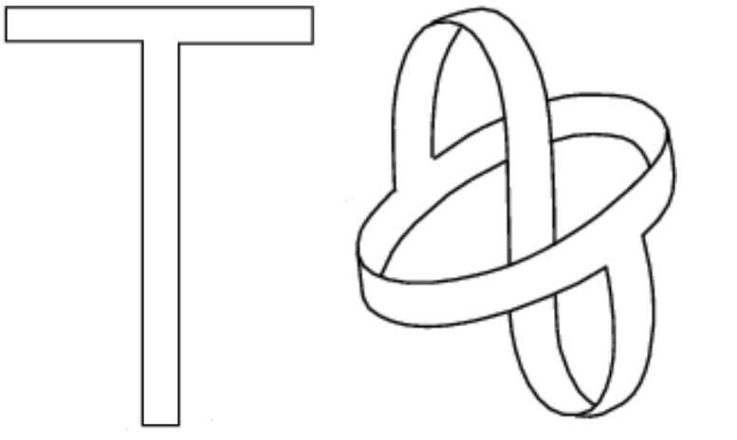
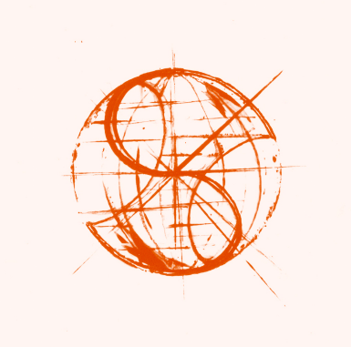
Giorgini Sphere
[Moebius shorts, from https://mathworld.wolfram.com/MoebiusShorts.html]
Giorgini Sphere follows the construction of the Moebius shorts, a topological surface which is obtained by starting with a T-shape, gluing the top part sides to form a ring (a cylinder), passing the bottom side upward to the ring, then turning it down, and finally gluing it without twisting to the border of the ring.
For Giorgini Sphere, one can start with a a spherical surface, and cut away two disks, which makes a cylinder; then, one has to glue a strip between the two boundaries as described above.
[Giorgini Sphere: drawings and the actual scuplture; diameter: 16 inches; material: alabaster]

Slide 9
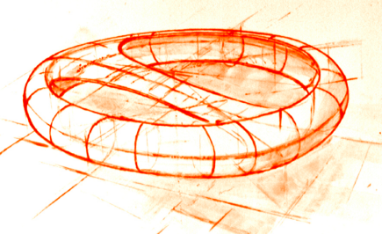
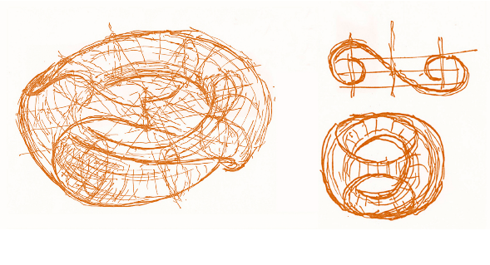
Giorgini Torus I and Giorgini Torus III
[Giorgini Torus I: drawings and the actual scuplture; diameter: 16 inches; height: 5 inches; material: alabaster]
Giorgini Torus I follows the same construction, but this time the cylinder to start with is obtained by removing the internal half of a torus (the part with negative curvature).
Similar reasonings apply to Giorgini Torus III.
[Giorgini Torus III: drawings and the actual scuplture; diameter: 16 inches; height: 5 inches; material: alabaster]

Slide 10
And then… topological equivalence
To one’s surprise, with basic notions from algebraic topology one can demonstrate that the four sculptures are topologically equivalent, as they all are non-orientable surfaces with one boundary and with non-orientable genus equal to 2: check the calculations in our paper!
The topological equivalence means they can be continuously deformed into one another, despite their geometric appearances are so different from each other!
1
2
3
4
5
6
7
8
[The continuous deformation taking Modified Klein to Giorgini Torus I, in eight steps. The red line marks the boundary along the deformation process]

Slide 11
And then… topological equivalence
To one’s surprise, with basic notions from algebraic topology one can demonstrate that the four sculptures are topologically equivalent, as they all are non-orientable surfaces with one boundary and with non-orientable genus equal to 2: check the calculations in our paper!
The topological equivalence means they can be continuously deformed into one another, despite their geometric appearances are so different from each other!
[The continuous deformation taking Modified Klein to Giorgini Torus I, in eight steps. The red line marks the boundary along the deformation process]

Slide 12
Giorgini Torus II and Giorgini Torus IV
[Giorgini Torus II; diameter: 16 inches; height: 5 inches; material: alabaster]
The topological type of two other sculptures (demonstrations to be published in a forthcoming paper):
Giorgini Torus II is a non-orientable surface with three boundaries which has the topology of a Möbius strip minus two disks;
Giorgini Torus IV is a non-orientable surface with two boundaries which has the topology of a sphere with five holes, three of which are capped by Möbius strips.
[Giorgini Torus II; diameter: 16 inches; height: 5 inches; material: alabaster]

Slide 13
Thank you
Daniela Giorgi, daniela.giorgi@isti.cnr.it
Visual Computing Lab, http://vcg.isti.cnr.it
Institute of Information Science and Technologies, Pisa
National Research Council of Italy

